Slide 1
Foundation Models in NLP:
Word embedding
Most slides are from Ch .6 of Dan Jurafsky and James Martin Speech and Language Processing

Slide 2
What do words mean?
First thought: look in a dictionary
http://www.oed.com/

Slide 3
Words, Lemmas, Senses, Definitions
lemma
sense
definition

Slide 4
Lemma pepper
Sense 1: spice from pepper plant
Sense 2: the pepper plant itself
Sense 3: another similar plant (Jamaican pepper)
Sense 4: another plant with peppercorns (California pepper)
Sense 5: capsicum (i.e. chili, paprika, bell pepper, etc)

Slide 5
A sense is the meaning component of a word

Slide 6
There are relations between senses

Slide 7
Relation: Synonymity
Synonyms have the same meaning in some or all contexts.
couch / sofa
big / large
automobile / car
vomit / throw up
Water / H₂0

Slide 8
Relation: Synonymity
Note that there are probably no examples of perfect synonymy.
Even if many aspects of meaning are identical
Still may not preserve the acceptability based on notions of politeness, slang, register, genre, etc.
The Linguistic Principle of Contrast:
Difference in form -> difference in meaning

Slide 9
Relation: Synonymity?
Water/H₂0
Big/large
Brave/courageous

Slide 10
Relation: Antonymy
Senses that are opposites with respect to one feature of meaning
Otherwise, they are very similar!
dark/light short/long fast/slow rise/fall
hot/cold up/down in/out
More formally: antonyms can
define a binary opposition
or be at opposite ends of a scale
long/short, fast/slow
Be reversives:
rise/fall, up/down

Slide 11
Relation: Similarity
Words with similar meanings. Not synonyms, but sharing some element of meaning
car, bicycle
cow, horse

Slide 12
Ask humans how similar 2 words are
word1 | word2 | similarity
vanish | disappear | 9.8
behave | obey | 7.3
belief | impression | 5.95
muscle | bone | 3.65
modest | flexible | 0.98
hole | agreement | 0.3
SimLex-999 dataset (Hill et al., 2015)

Slide 13
Relation: Word relatedness
Also called "word association"
Words be related in any way, perhaps via a semantic frame or field
car, bicycle: similar
car, gasoline: related, not similar

Slide 14
Semantic field
Words that
cover a particular semantic domain
bear structured relations with each other.
hospitals
surgeon, scalpel, nurse, anaesthetic, hospital
restaurants
waiter, menu, plate, food, menu, chef),
houses
door, roof, kitchen, family, bed

Slide 15
Relation: Superordinate/ subordinate
One sense is a subordinate of another if the first sense is more specific, denoting a subclass of the other
car is a subordinate of vehicle
mango is a subordinate of fruit
Conversely superordinate
vehicle is a superordinate of car
fruit is a subodinate of mango
Superordinate | vehicle | fruit | furniture
Subordinate | car | mango | chair

Slide 16
WordNet
A large lexical database
Includes senses, synsets, semantic relations, etc
It is adapted to many languages

Slide 17
Problems with resources like WordNet
A useful resource but missing nuance:
e.g., “proficient” is listed as a synonym for “good”
This is only correct in some contexts
Missing new meanings of words:
e.g., wicked, nifty, wizard, genius, ninja, bombest
Impossible to keep up-to-date!
Subjective
Requires human labor to create and adapt
Can’t be used to accurately compute word similarity
From cs224n-2022 standford NLP course

Slide 18
Ludwig Wittgenstein
"The meaning of a word is its use in the language"

Slide 19
Let's define words by their usages
In particular, words are defined by their environments (the words around them)
Zellig Harris (1954): If A and B have almost identical environments we say that they are synonyms.

Slide 20
What does ongchoi mean?
Suppose you see these sentences:
Ong choi is delicious sautéed with garlic.
Ong choi is superb over rice
Ong choi leaves with salty sauces
And you've also seen these:
…spinach sautéed with garlic over rice
Chard stems and leaves are delicious
Collard greens and other salty leafy greens
Conclusion:
Ongchoi is a leafy green like spinach, chard, or collard greens

Slide 21
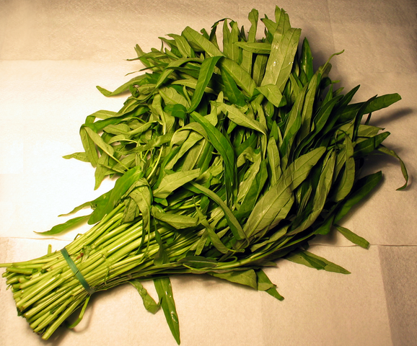
Ong choi: Ipomoea aquatica "Water Spinach"
Yamaguchi, Wikimedia Commons, public domain

Slide 22
We'll build a new model of meaning focusing on similarity
Each word = a vector
Similar words are "nearby in space"

Slide 23
We define a word as a vector
Called an "embedding" because it's embedded into a space
The standard way to represent meaning in NLP
Fine-grained model of meaning for similarity
NLP tasks like sentiment analysis
With words, requires same word to be in training and test
With embeddings: ok if similar words occurred!!!
Question answering, conversational agents, etc

Slide 24




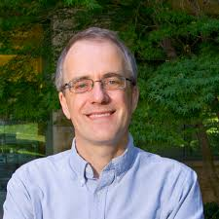
Dense embeddings you can download!
Word2vec (Mikolov et al.)
https://code.google.com/archive/p/word2vec/
Fasttext http://www.fasttext.cc/
Glove (Pennington, Socher, Manning)
http://nlp.stanford.edu/projects/glove/

Slide 25
Word2vec
Popular embedding method
Very fast to train
Code available on the web
Idea: predict rather than count

Slide 26
Word2vec
Instead of counting how often each word w occurs near "apricot"
Train a classifier on a binary prediction task:
Is w likely to show up near "apricot"?
We don’t actually care about this task
But we'll take the learned classifier weights as the word embeddings

Slide 27
Brilliant insight: Use running text as implicitly supervised training data!
A word s near apricot
Acts as gold ‘correct answer’ to the question
“Is word w likely to show up near apricot?”
No need for hand-labeled supervision
The idea comes from neural language modeling
Bengio et al. (2003)
Collobert et al. (2011)

Slide 28
Word2Vec: Skip-Gram Task
Word2vec provides a variety of options.
Let's do
"skip-gram with negative sampling" (SGNS)

Slide 29
Skip-gram algorithm
Treat the target word and a neighboring context word as positive examples.
Randomly sample other words in the lexicon to get negative samples
Use logistic regression to train a classifier to distinguish those two cases
Use the weights as the embeddings

Slide 30
Skip-Gram Training Data
Training sentence:
... lemon, a tablespoon of apricot jam a pinch ...
c1 c2 target c3 c4
Assume context words are those in +/- 2 word window

Slide 31
Skip-Gram Goal
Given a tuple (t,c) = target, context
(apricot, jam)
(apricot, aardvark)
Return probability that c is a real context word:
P(+|t,c)
P(−|t,c) = 1−P(+|t,c)

Slide 32
How to compute p(+|t,c)?
Intuition:
Words are likely to appear near similar words
Model similarity with dot-product!
Similarity(t,c) ∝ t ∙ c
Problem:
Dot product is not a probability!
(Neither is cosine)

Slide 33
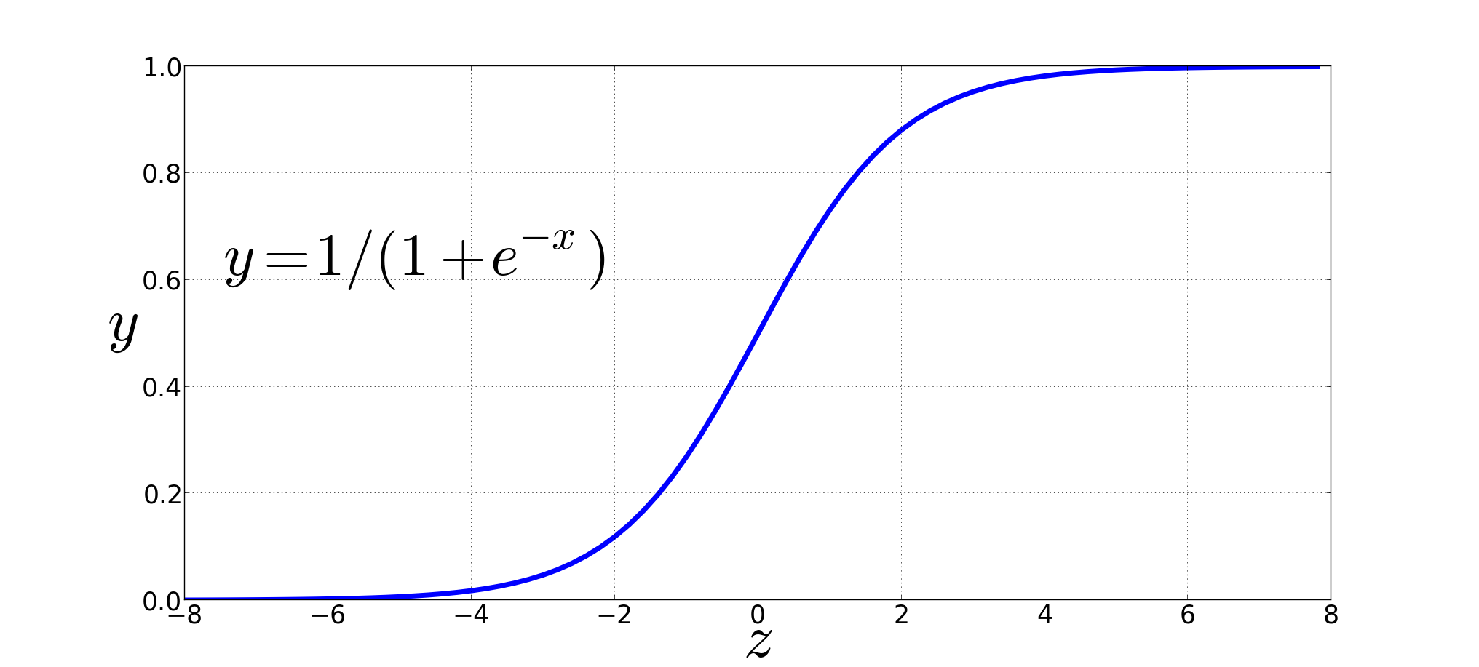
Turning dot product into a probability
The sigmoid lies between 0 and 1:

Slide 34
Turning dot product into a probability

